Slide 1
Demo

Slide 2
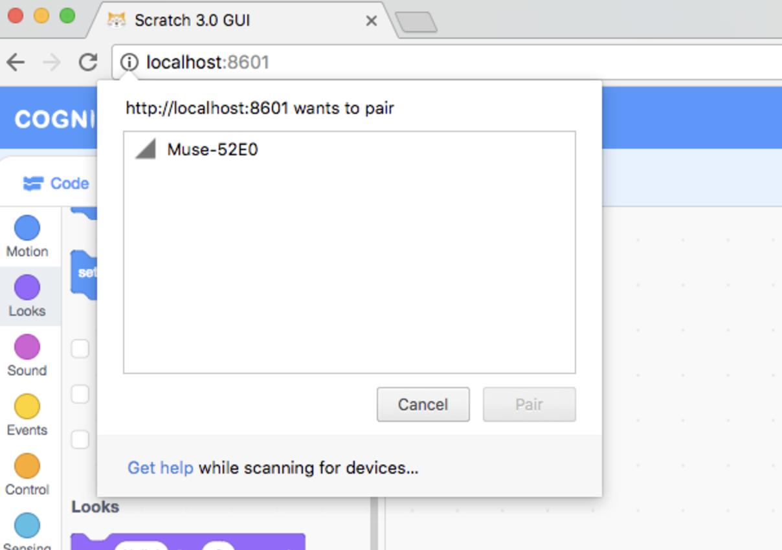
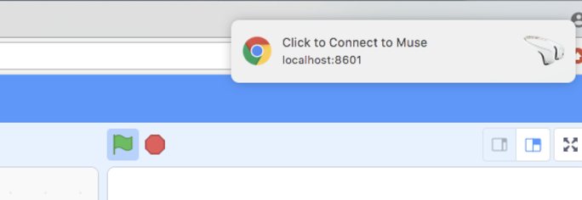
Pairing the Muse headset
Pair the Muse headset by loading the Muse extension and pressing the “connect Muse” block

Slide 3
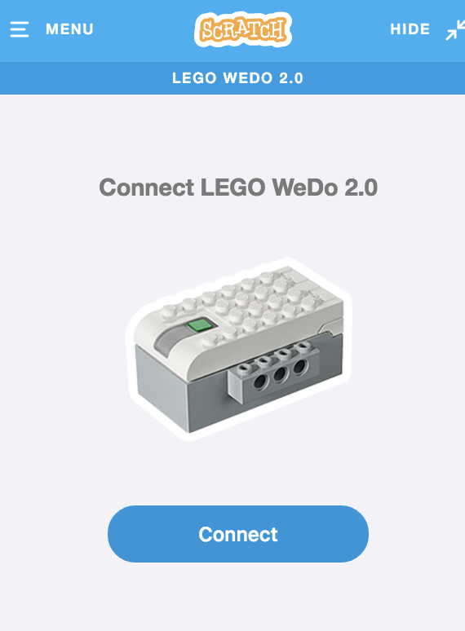
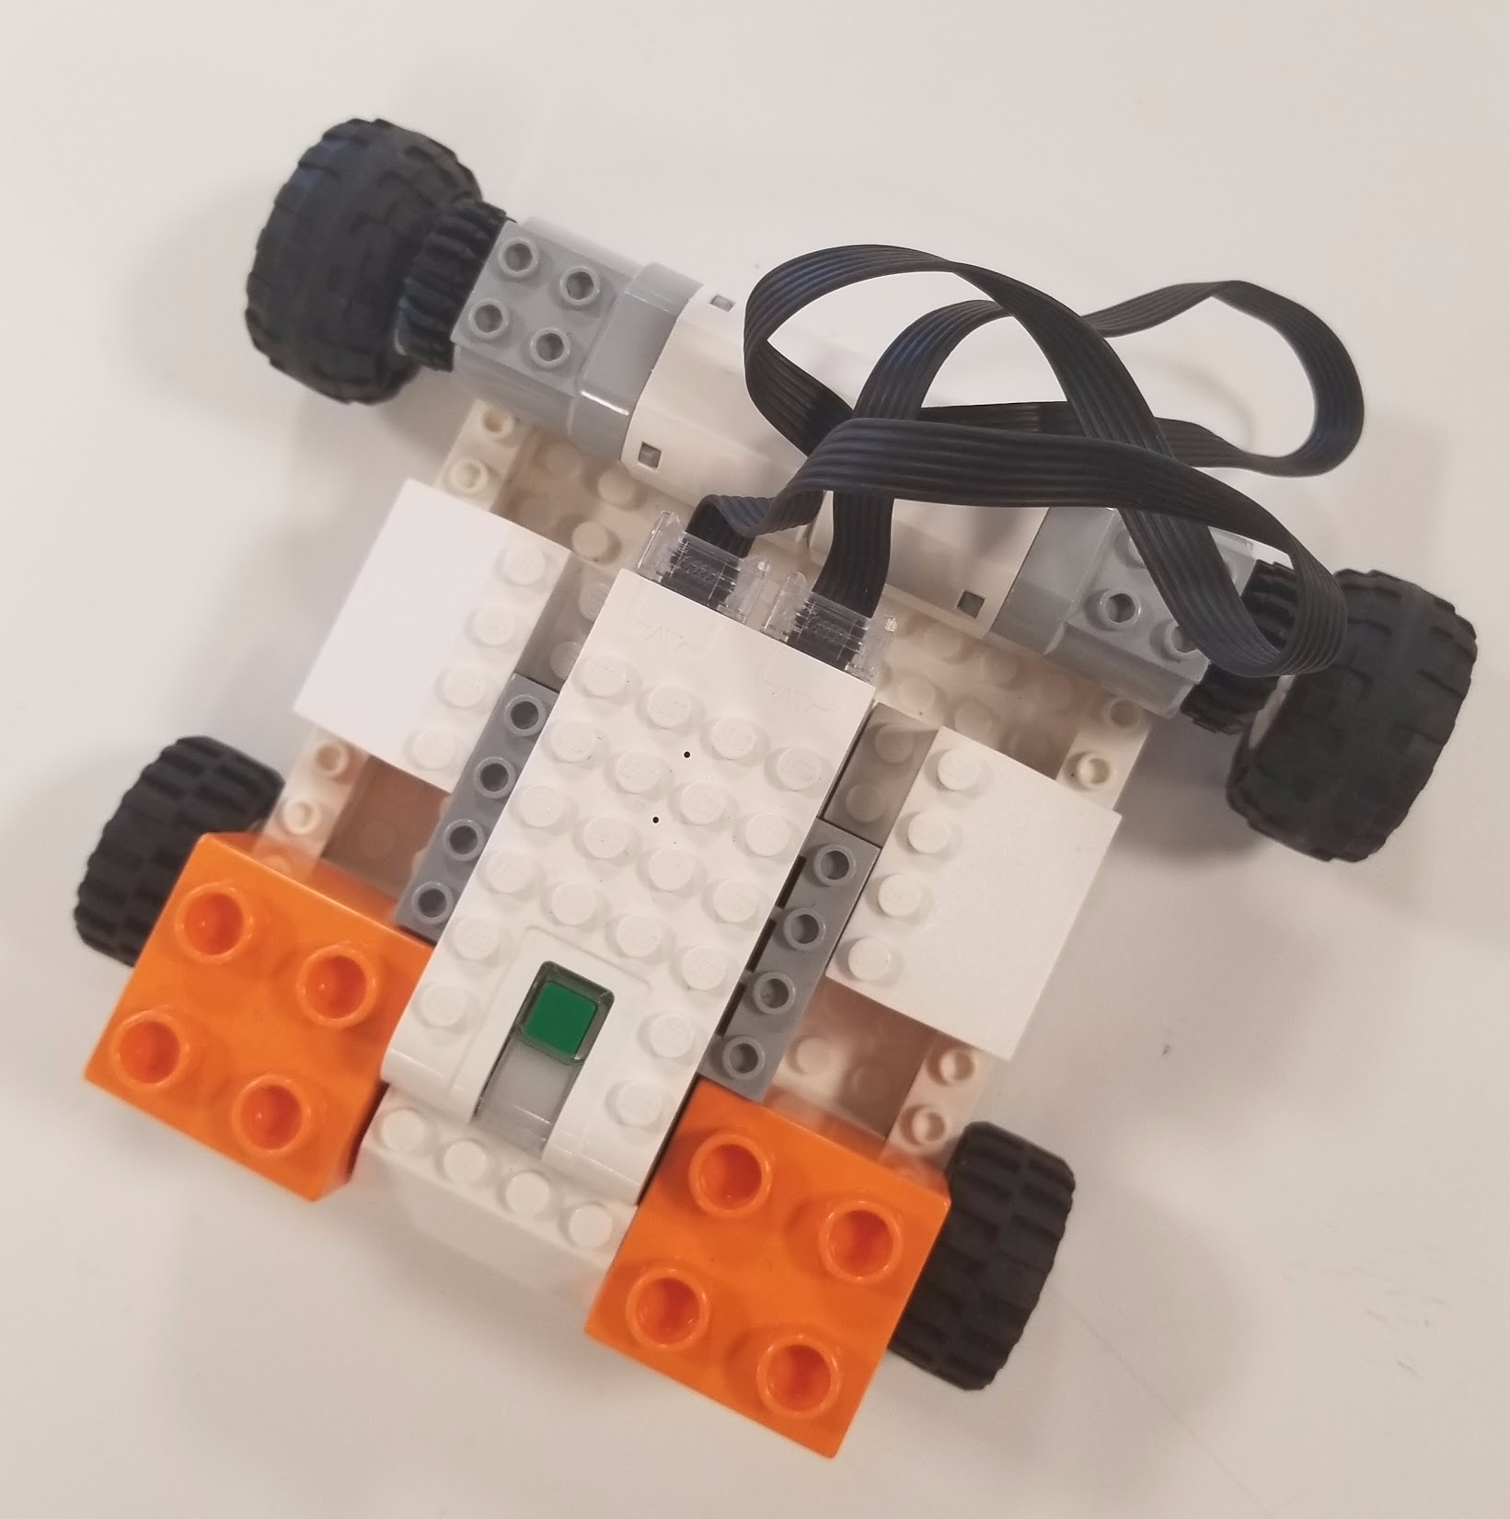
Connecting the Wedo
Download and open the Scratch Device Manager
Load the Wedo extension
Press the connect button on the SDM and press the Wedo’s button
Once connected, the Wedo’s should have a solid color (not blinking)

Slide 4
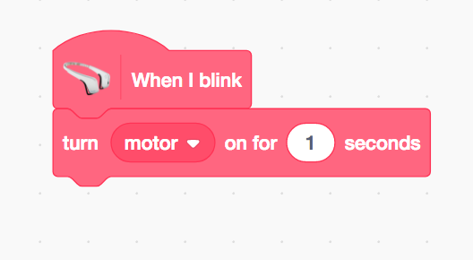
Try simple code
Build a simple program using the Wedo and Muse extension blocks
For example, make a program that will move the Wedo every time you blink

Slide 5
Tips
Let the headband rest on your forehead for a while before testing any functions
This way, the headset is given time to calibrate and recognize better
When blinking, don’t try to blink too fast

Slide 6
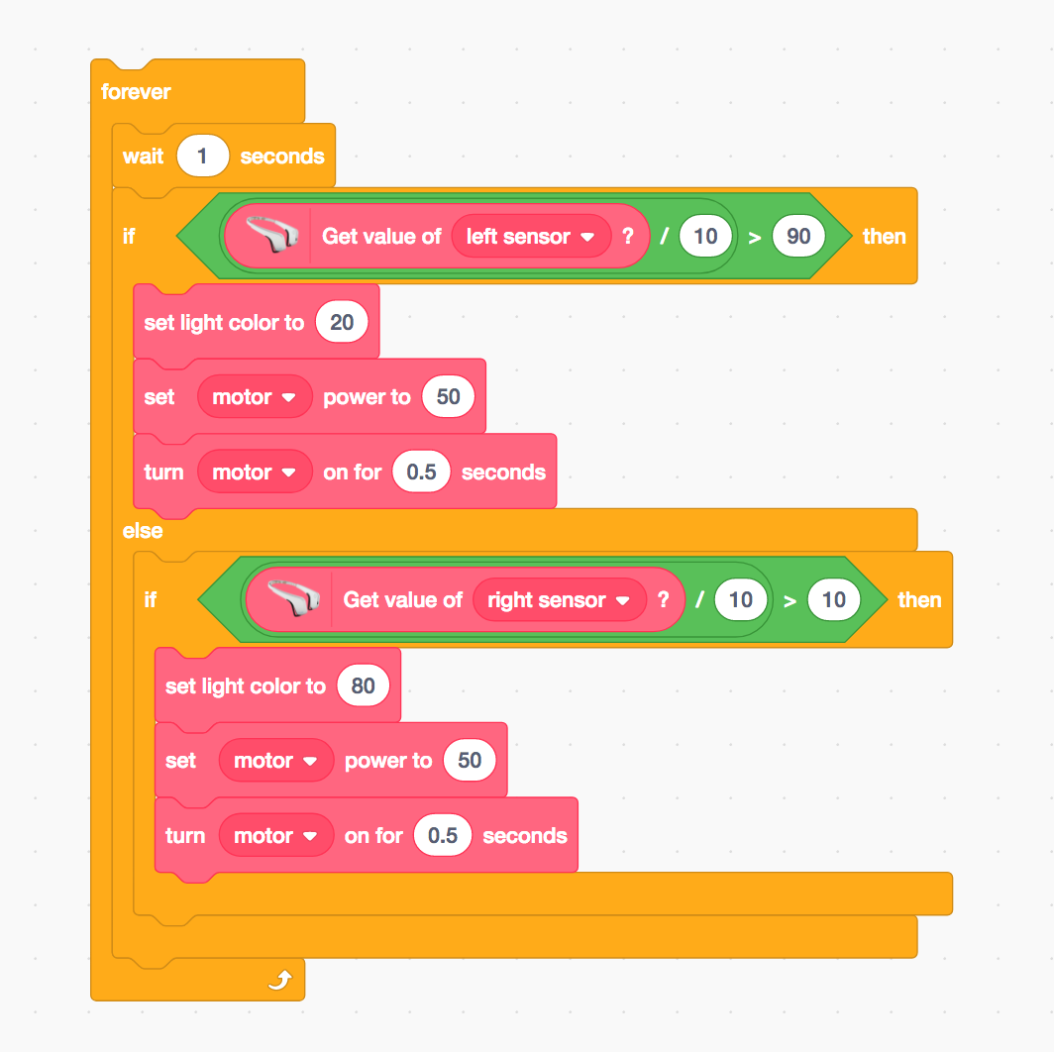
Potential Code Kids Would Play With

